Slide 1
HPV Vaccine: Clinical development, Efficacy and Safety
Ricardo Rüttimann
Pediatric Infectious Diseases
FIDEC Vaccines Unit Director
International Vaccines Symposium
Yerevan, 17 & 18 October 2018

Slide 2
HPV Infections & Vaccines: General Concepts
HPV is the most common viral infection of the reproductive tract in both men and women, including precancerous lesions that may progress to cancer
Between 50 to 80% of women adquired at least one HPV infection lifelong
50% of HPV are oncogenic types
Infections and lesions are generally asymptomatic
HPV genotypes
12 are oncogenic or high risks
Persistent infection with 16 and 18 are responsible >70% of all Cervical Cancer (CC) worldwide
6 and 11 are responsible >90% of genital warts
Natural infections does not protect to future infections
Vaccinating adolescents is the most cost/effective strategy
Vaccines are prophylatic not therapeutic
Baseman JG y colaboradores. J Clin Virol 2005; 32 Suppl 1; S16−24;
Ho GY y colaboradores. N Engl J Med 1998; 338: 423–8;
Brown DR y colaboradores. J Infect Dis 2005; 191: 182–92
Muñoz N y colab. N Engl J Med 2003; 348: 518–27.

Slide 3
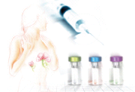
Strategy for Cervical Cancer Prevention
+
Screening
Pap smear or
Papanicolaou
Vaccination
Combination of Primary and Secondary Prophylaxis
Notes:
Prevención secundaria
La prueba ‘Frotis Pap’ constituye la base de los programas de valoración de cáncer cervical en todo el mundo. Durante un examen ginecológico se toma una muestra de células de la capa superior del cérvix, la cual se distribuye sobre un portaobjetos de vidrio, se fija, y se transporta al laboratorio, donde se procesa y tiñe para que los patólogos capacitados del laboratorio puedan examinar microscópicamente las células capturadas. Las células que están transformándose en células cancerosas muestran características nucleares anormales. Está técnica la desarrolló el Dr. Papanicolaou en los años 50s, de ahí su nombre.
Utilizar esta prueba en los programas de valoración es caro y requiere tiempo. La prueba en sí, las repetidas visitas para comentar los resultados, y la posible necesidad de un seguimiento colposcópico más detallado en caso de resultados anormales en la prueba, causan alteración psicológica en la mujer en cuestión, y por supuesto, una carga para el sistema médico que les da servicio.
Referirse a la pregunta 4 en la sección ‘Preguntas sobre la enfermedad’ de las Preguntas Formuladas Frecuentemente’.

Slide 4
HPV Vaccines
Intended to be administered if possible before the onset
of sexual activity, before first exposure to HPV infection
Using recombinant DNA technology, all 3 vaccines are
prepared from the purified L1 structural protein that
self-assemble to form HPV type-specific empty shells
termed virus-like particles (VLPs)
None of the vaccines contains live biological products
or viral DNA, and are therefore non-infectious
Do not contain antibiotics or preservative agents
By 31 March 2017, 71 countries (37%) had introduced
HPV vaccine in their NIP for girls, and 11 countries (6%)
also for boys
Human papillomavirus vaccines: WHO position paper, May 2017

Slide 5
HPV Vaccines
Characteristics | Gardasil | Cervarix
Genotypes | 6 (20ug), 11 (40ug), 16 (40ug), 18 (20ug) | 16, 18 (20ug each)
 | 6, 11, 16, 18, 31, 33, 45, 52, 58 (20 to 60ug)
Adyuvants | Alum | AS04 (Alum + MPL)
Recombinant produced in | Sacharomyses cerevisiae | Baculovirus system
Schedule (years) | 0 – 6 months (9-13 y) | 0 – 6 months (9-14 y)
 | 0-2-6 months >14 y | 0-1-6 months >15 y
All 3 vaccines are prepared from the purified L1 structural protein (VLPs)
None of the vaccines contains live biological products or viral DNA (non-infectious)
By 31 March 2017, 71 countries (37%) had introduced HPV vaccine in their NIP for
Girls and 11 countries (6%) also for Boys

Slide 6
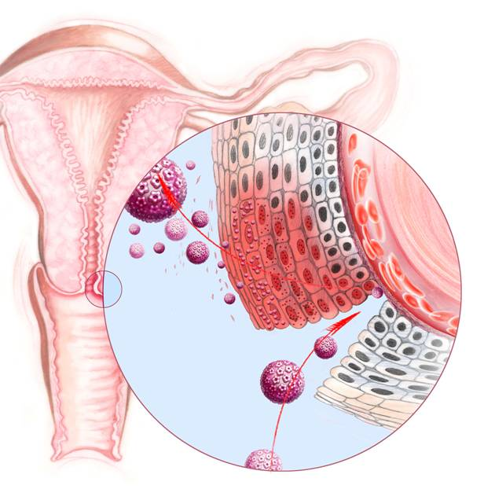
HPV natural infection is unrecognized by the immune system
The virus is not introduce to the dendrytic cells
No Viremia is developed
It is a local intra-epithelial infection
at the mucosal level
Failure to develop an effective
cell mediated immune response
results in persistent infection
and, in the case of the high-risk HPVs,
an increased probability of
progression to CIN 2/3
1.Stanley M. Vaccine 2006; 24: S106-13. Vaccine 2006; 24: S16-22, Stanley M. HPV Today 2007; 11: 1-16
Notes:
6

Slide 7
HPV Vaccines: mechanism of protection
Tranusdate neutralizing antibodies bind the HPV virus in genital secretions
Immune response to human papillomavirus after prophylactic vaccination with AS04-adjuvanted HPV-16/18 vaccine: Improving upon nature. Gynecol Oncol 2008;110(3 Suppl 1):S1-10.

Slide 8
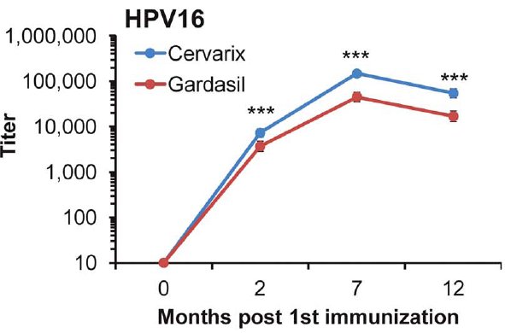
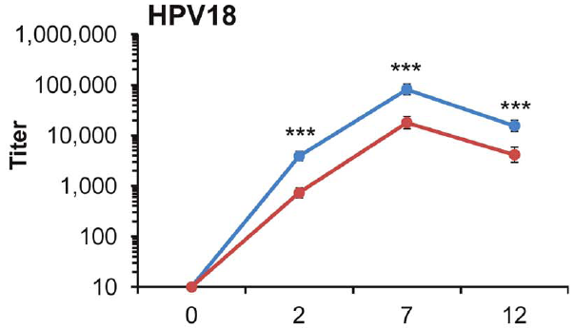
HPV Vaccine: Neutralizing Antibodies Response
Schedule 0-1/2-6 months
All girls (9-13 y) were seropositives for HPV 16 and 18 after the first dose
n=94
n=91
n=91
n=92
n=93
n=98
n=97
n=96
***p<0.001
Draper E et al. PlosOne 2013

Slide 9
HPV Vaccine Efficacy against HPV types 16/18 CIN2+ Naïve Cohort
PATRICIA study. Efficacy cohort N 11.644 young women 15 - 25 years. Bivalent vaccine
Endpoint | Vaccine Efficacy
 | % | 95% CI
CIN2+ HPV 16/18 | 99.0 | 94.2-100
CIN3+ HPV 16/18 | 100 | 85.5-100
FUTURE II study. Efficacy cohort N 12.167 young women 15 - 26 years. Cuadrivalent vaccine
Endpoint | Vaccine Efficacy
 | % | 95% CI
CIN2+ HPV 16/18 | 98.0 | 86-100
CIN3+ HPV 16/18 | 97 | 79-100
Vaccine efficacy showed almost 100% protection against genital warts associated
with HPV-6 and HPV-11
Lehtinen M, et al. Lancet Oncology, 2012;13:89-99 The FUTURE II Study Group. N Engl J Med 2007; 356:1915-27

Slide 10
10 years Inmunogenicity for HPV 16 and 18 (Bivalent vaccine)
HPV-001 study
HPV-007 study
HPV-023 study
HPV-16
HPV
Control
100% seropositivity
≥14 than natural infection
GMT (EL.U/mL)
HPV-18
100% seropositivity
HPV
Control
≥10-than natural infection
GMT (EL.U/mL)
Paavonen J et al. Lancet 2007;369:2161–217, Naud P, et al 27th IntPVConf Berlin, 2011

Slide 11
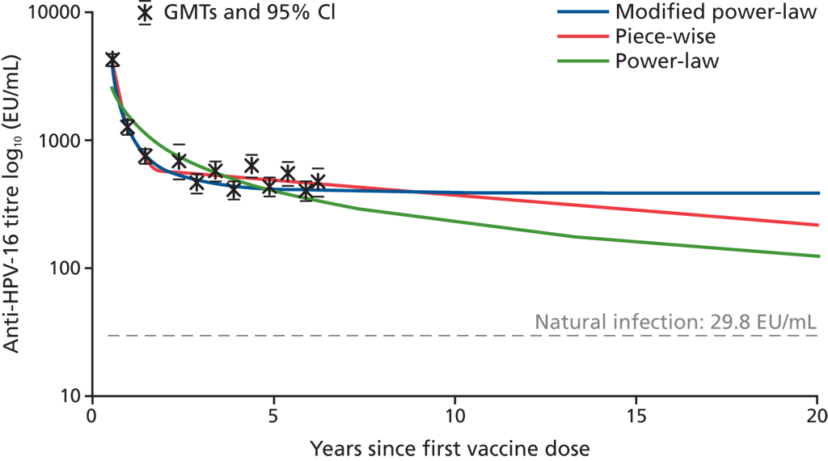
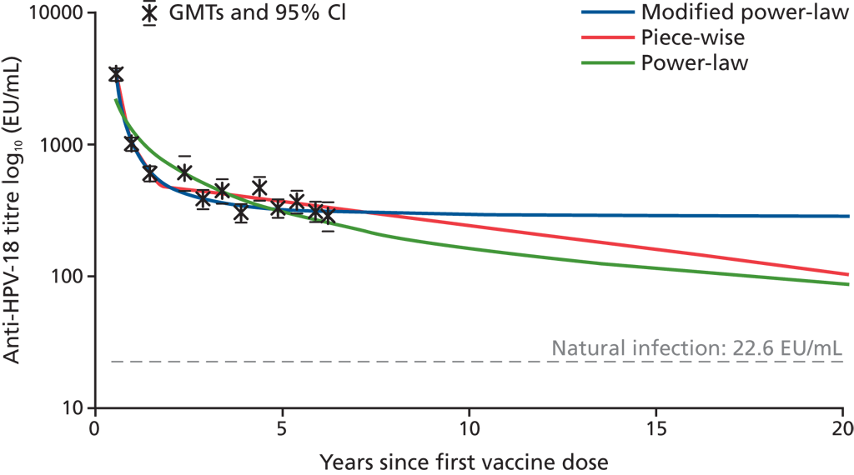
HPV Vaccine: Predicted model of long term Protection based on Immunogenicity
Antibodies level against HPV-16 & 18 are detectable and above natural infection
at least for 20 years
HPV-16
HPV-18
CI; EU, ELISA; GMT
This model considered immunogenicity data after 6 years of immunization
Eurogin, Nice, Francia, Nov 12-15, 2008.

Slide 12
Vaccine efficacy (Bivalent Vaccine) against Non Vaccine types CIN2+
Naïve cohort
End of the study (44 months)
HPV type | Group | End of the study
 |  | N | n | Efficacy % CI 95%
HPV-31 | Vaccine | 5466 | 2 | 89.4 (65.5, 97.9)
 | Control | 5452 | 25
HPV-33 | Vaccine | 5466 | 5 | 82.3 (53.4, 94.7)
 | Control | 5452 | 24
HPV-45 | Vaccine | 5466 | 0 | 100.0 (41.7; 100.0)
 | Control | 5452 | 8
Basal DNA negative
N = number of evaluable women
n = number of women at least with one event
Wheeler et al. Lancet oncol 2012

Slide 13
HPV Vaccines Safety
The WHO Global Advisory Committee for Vaccine Safety (GACVS) regularly reviews the evidence on the safety of HPV vaccines
Post-licensure surveillance data from countries such as the United States, Australia, Japan, as well as other countries as any concerns arise
Data from all sources continue to be reassuring regarding the safety profile of all 3 vaccines
The GACVS has noted that policy decisions based on weak evidence, leading to lack of use of safe and effective vaccines, can result in significant harm
In January 2016, GACVS concluded that the available evidence did not suggest any safety concern regarding the use of HPV vaccines
Human papillomavirus vaccines: WHO position paper, May 2017

Slide 14
HPV Vaccines Safety, cont…
Local reactions: Pain is more commonly reported at the time of injection than in the hours and days following vaccination
In clinical trials of the HPV4, injection site reactions consisted of pain (84%), erythema (<25%) and swelling (25%)
In >1000 women aged 18–45, local reactions occurred more frequently with HPV2 than HPV4
Systemic reactions: In pre-licensure clinical trials pyrexia was the only reported adverse event, >10% of vaccinees and more frequently than in placebo groups (10.1% and 8.4%, respectively)
Other minor systemic adverse events were reported <0.5%. Mild systemic adverse events possibly related to vaccination included headache, dizziness, myalgia, arthralgia, and gastrointestinal symptoms
In January 2016, WHO-GACVS concluded that the available evidence did not suggest any safety concern regarding the use of HPV vaccines
Human papillomavirus vaccines: WHO position paper, May 2017

Slide 15
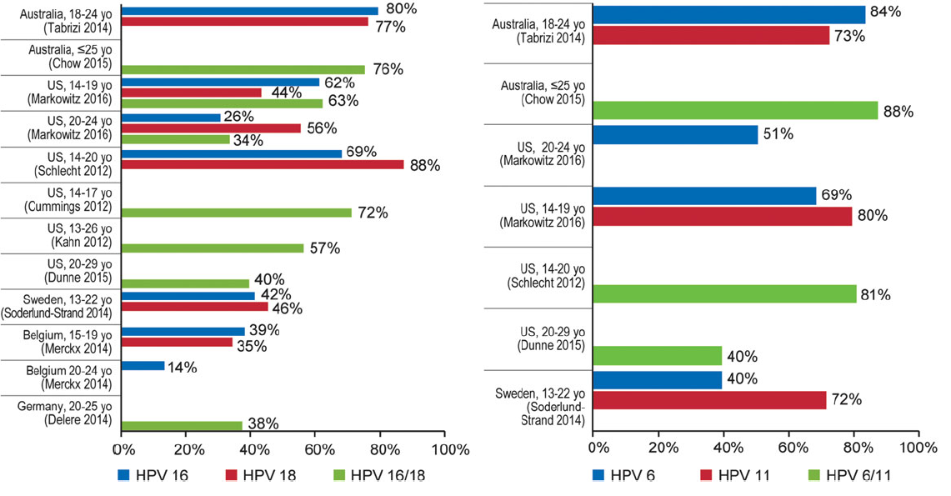
Impact and Effectiveness of the Quadrivalent HPV Vaccine A systemaic review of 10 years of Real-World Experience
Percentage reduction of prevalent HPV 16 & 18
Percentage reduction of prevalent HPV 6 & 11
Garland S, et al. CID 2016: 63, 519-527

Slide 16
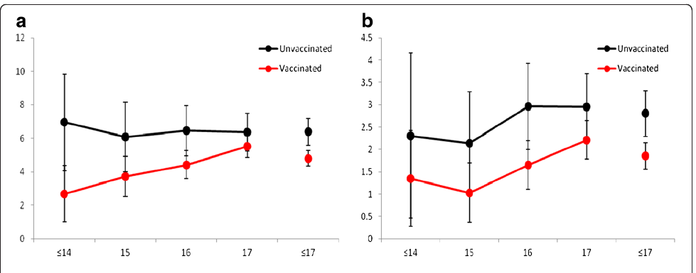
Impact of Quadrivalent HPV Vaccine in Cervical Lesions in Australia
Population Based Study in Victoria, Australia
Vaccine Coverage 86/82/75% for 1/2 or 3 doses (12 - 17 years)
a and b: CIN3 and AIS. Vaccine Effectiveness 47.5% (22.7-64.4) 5 years follow up
Genital warts 45 to 87% reduction
Low-grade lesions 45% reduction
High-grade lesions 80% reduction
Garland S, et al. CID 2016: 63, 519-527
Gertig D, Brotherton J, et al. BMC 2013, 11:227

Slide 17
Conclusions
Cervical cancer and other HPV-related diseases are global public health problems
WHO recommendation encourage that HPV vaccines should be included in NIP
Cervical cancer, which comprises 84% of all HPV-related cancers, should remain the priority for HPV immunization
Prevention of cervical cancer is best achieved through the immunization of girls, prior to sexual debut
All 3 licensed HPV vaccines – bivalent, quadrivalent and nonavalent – have excellent safety, efficacy and effectiveness profiles
Vaccination targeting multiple age cohorts of girls (9 – 18) years at the time of HPV vaccine introduction would result in faster and greater population impact than vaccination of single age cohorts, due to the estimated increase in direct protection and herd immunity

Slide 18
Julia
Mariana
Happy to be protected against Cervical Cancer

